Slide 1
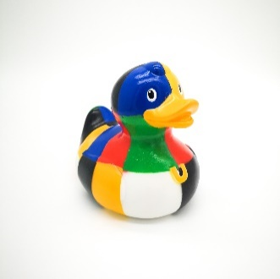
Children’s Hearings Advocacy webinar
What Hearings-experienced young people think about advocacy.

Slide 2
Advocacy and
40 Calls to Action
Give me information about how to get a children’s rights or advocacy worker to support me
Respect my voice by listening, believing, valuing and including me when deciding what happens in my life
Have lots of different ways for me to share my views and make sure my voice is at the centre of my hearing
Do not judge me. Get to know me. Try to step into my shoes and understand what my life is like and what is important to me
I must be supported and be able to speak freely in my hearing

Slide 3
What Hearings-experienced young people think about advocacy
“It is important that someone
is there just for the child”
“It is important you have a choice.
You might feel confident and
not want one. Choice is important”
“If they can get one now, which is great.
I would encourage everyone to get one”
“Should have more care experienced
people as advocacy workers. They can relate to you and you can relate to them”
“They can also pass on your views
on your behalf”

Slide 4

Children’s Hearings Advocacy webinar
What Hearings-experienced young people think about advocacy

