Slide 1

A Guide to Referral to the Children’s Reporter
2024
Notes:
The following slides complement the new Guide to Referral to the Children’s Reporter.
This is a refresh of the initial CHIP Guidance document that was published in August 2015, the 2015 Guidance has been updated to be more accessible and also to be easier to follow.

Slide 2
Introduction
This is a short online introduction to the new National Guide to Referral to the Children’s Reporter
The Guide is intended for professionals who may need to make a referral
The Guide has also been written to be accessible to families who are experiencing a referral
If you are experiencing a referral and you have questions or require more support, then please speak with your child’s social worker or contact your local Reporter, online details at Office Locations - SCRA
Notes:
This guide is aimed principally at professionals who may need to make a referral to SCRA.
It is hoped that the new Guide will also be useful to others such as families whose children are referred and for others wanting to learn about the referral process itself.
Please contact your local SCRA office or your child’s social worker if you need more information.

Slide 3

CHIP
No, not
The Children’s Hearings Improvement Partnership brings together representatives from all key partners in the Hearings System
It emphasises the importance of working together in partnership
The Children’s Hearing works best when everyone understands not just their own but other agencies roles and responsibilities
Notes:
The Children’s Hearings Improvement Partnership, referred to as the CHIP, is a multi-agency group that is chaired and co-ordinated by the Scottish Government. It brings together multi-agency partners from across the Hearings System.
The CHIP is built on partnership and co-operation – within a defined set of roles, duties and obligations. Bringing these key interests together – with a focus on delivering change and improvement – is core to the CHIP.
Children’s Hearings work best when each person understands not only their own role and responsibility but also the roles and responsibilities of other participating agencies in the hearings system-and how these interact with each other.

Slide 4
Children’s Hearings Improvement Partnership
Children’s Hearings Improvement Partnership | (chip-partnership.co.uk)
Online space for multi-agency documents and information
Designed for practitioners
Information, guidance, training, resources
Link to Our Hearings, Our Voice
Guide on Referral to the Reporter
Notes:
The CHIP has its own website where you can find helpful information about the operation of and practice within the children’s hearings system.
It includes a link to Our Hearings Our Voice, the young people’s board for the hearings system, and a host of information, guidance documents and training resources designed to help practitioners improve practice.
You can find the new Guide on Referral to the Reporter document on the CHIP website, using the link here.

Slide 5
Who is the guide for?
The guide is for anyone who is thinking about making a referral to the Children’s Reporter
It covers the law
It covers the approach to take to a referral
It provides some practical advice
Anyone may refer a child to the Children’s Reporter
A child is someone under 18
Notes:
Anyone can make a referral to SCRA for a child. So really, this guide is for anyone.
This guide provides basic information about the law and the referral process .
It also offers some practical advice on how to make a referral and the kind of information that is helpful for you to give to the children’s reporter.

Slide 6
Are there children who can’t be referred?
Yes
At the moment a child who is not yet born cannot be referred
In some circumstances a child over 16 can be referred
The Children’s (Care and Justice) (Scotland) Act 2024 will change the age restrictions will are currently there for some children when it is fully in force
Notes:
When the Children’s (Care and Justice)(Scotland) Act 2024 comes into force you will be able to make a referral for any child up to the age of 18 years-whether they are in conflict with the law or in need of care and protection.
At the moment only children 16 years and over who are already on a compulsory supervision order ;who have an open referral when they turned 16 ; who are sent to the children’s hearing by a court or who have been transferred by a local authority into secure accommodation can be referred.
A child cannot be referred before it is born, but they can be placed on the child protection register pre- birth.

Slide 7
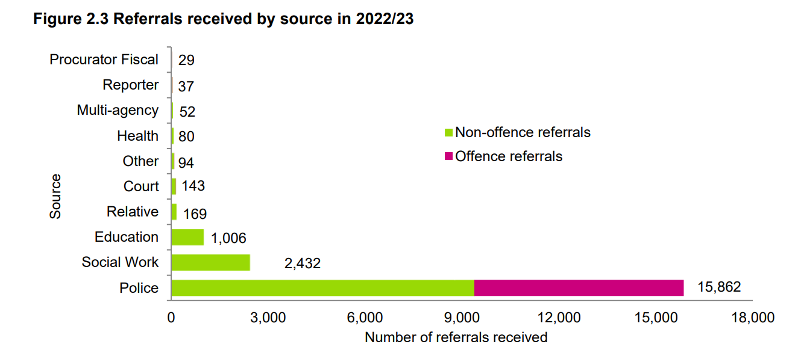
Notes:
This slide sets out who made referrals to SCRA for the year 2022/23.
You will see that most referrals are for care and protection grounds, not ‘offences’ where children are in conflict with the law.
The police continue to make the largest number of referrals.

Slide 8
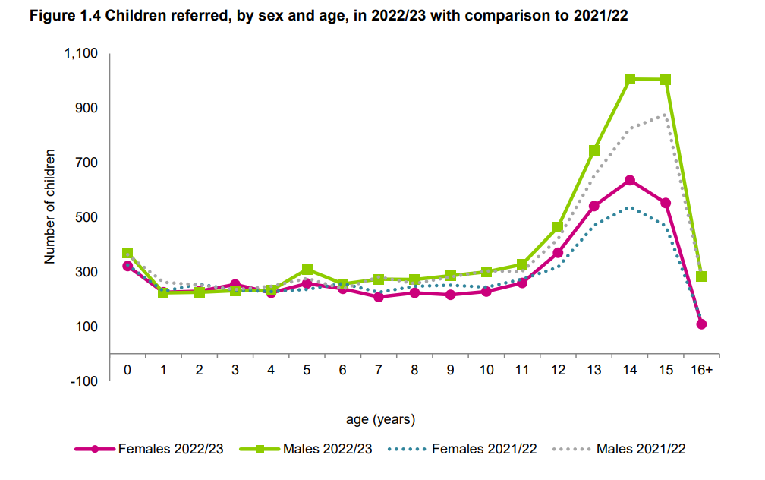
Notes:
Here you can see that the peak age for referral to the reporter is between the ages of 14 and 15 - for both girls and boys.

Slide 9
Section 60 - Local authority's duty to provide information to Principal Reporter
(1)If a local authority considers that it is likely that subsection (2) applies in relation to a child in its area, it must make all necessary inquiries into the child's circumstances.
(2)This subsection applies where the local authority considers—
(a)that the child is in need of protection, guidance, treatment or control, and
(b)that it might be necessary for a compulsory supervision order to be made in relation to the child.
(3)Where subsection (2) applies in relation to a child the local authority must give any information that it has about the child to the Principal Reporter.
Notes:
The local authority is obliged by law to provide information to the Principal Reporter-that is to SCRA- if it considers the child needs protection, guidance, treatment or control and it might be necessary for a compulsory supervision order (usually referred to as a CSO) to be made.

Slide 10
Section 61 - Constable's duty to provide information to Principal Reporter
(1)This section applies where a constable considers—
(a)that a child is in need of protection, guidance, treatment or control, and
(b)that it might be necessary for a compulsory supervision order to be made in relation to the child.
(2)The constable must give the Principal Reporter all relevant information which the constable has been able to discover in relation to the child.
(3)If the constable makes a report under [section 20(1)(d) of the Police and Fire Reform (Scotland) Act 2012 (asp 8)] in relation to the child, the constable must also make the report to the Principal Reporter.
Notes:
You will see from this slide that a similar duty is placed upon the police.

Slide 11
Legal tests (referral criteria)
Part 6 of the Children’s Hearings (Scotland) Act 2011
the child is in need of protection, guidance, treatment or control
and
it might be necessary for a Compulsory Supervision Order to be made in relation to the child
Notes:
The legal test for making a referral is contained in Part 6 of the Children’s Hearings (Scotland) Act 2011 and is set out here-
That is that the child the child is in need of protection, guidance, treatment or control and that it might be necessary for a Compulsory Supervision Order to be made in relation to the child.
Both elements of the test require to be met in order for a children’s hearing to be arranged.

Slide 12
How does this fit with GIRFEC?
GIRFEC – Getting it Right for Every Child – is one of the policy frameworks for the Children’s Hearing
Support is focussed on a child’s wellbeing
Wellbeing is measured using the 8 SHANARRI indicators –
safe, happy, achieving, nurtured, active, respected, responsible and included
Is voluntary engagement enough, or likely to be enough, to meet the child’s needs?
Notes:
When considering whether or not to make a referral, a key question to ask is whether voluntary engagement with services is meeting the child’s needs or will voluntary engagement alone be likely to meet the child’s needs.
The GIRFEC framework should be used when assessing the child’s wellbeing with consideration of the 8 SHANARRI indicators listed here.

Slide 13
Balance of risk and support
MAY v MUST
Move from:
working with a family with no legal or statutory basis
to
working with a family on a statutory basis, under a legal order
Notes:
Statutory intervention in the life of a child is a serious step that should never be taken lightly.
Referral to the reporter can lead to a children’s hearing taking place and may end with the child being placed on a compulsory supervision order which the child and their family must comply with- whether they want to or not.

Slide 14
5 key questions
What is getting in the way of this child or young person’s wellbeing?
Do I have all the information I need to help this child or young person?
What can I do now to help this child or young person?
What can my agency do to help this child or young person?
What additional help – if any – may be needed from others?
Notes:
Here are 5 key questions you should ask before making a referral to SCRA.

Slide 15
Making a referral
Emergency action
‘Quick’ or ‘urgent’ referral (without testing voluntary support first)
Child in conflict with the law
A referral can result in a Children’s Hearing
You can speak to the Children’s Reporter before you make a referral – to clarify thinking, understand the application of the referral criteria
Appendices to the Guide have additional information
The Children’s Reporter cannot require or prevent a referral
Notes:
Sometimes it is necessary to take emergency action to protect a child- leaving no time to work with the child and their family on a voluntary basis.
This is most often seen when the local authority applies to the court for a Child Protection Order (or CPO for short). A CPO is made to the Sheriff Court – but will always result in a referral to the reporter, if the Court grants the CPO.
A child in conflict with the law is dealt with in exactly the same way in the children’s hearing system as a child who is in need of care and protection.
Any referral can result in a children’s hearing being held and a CSO being made.
You can speak to the reporter to clarify your thinking about a child’s situation, but the reporter can not tell you whether to make a referral or not.
Please refer to the appendices in the guide for further information.

Slide 16
Do I let a family know?
The consent of a child and family is not needed for a referral to the Children’s Reporter
Good practice – inform the child and family
Children’s Reporter will write letters
If there needs to be a safety plan around communications let the Children’s Reporter know
If a family doesn’t know about a referral, tell the Children’s Reporter
Notes:
Although it is good practice to let a child and family know that you are making a referral, it is not necessary to obtain their consent in advance.
Once the referral has been made it is reporter practice to write a letter to the child and family to inform them of this; to advise them of the next steps that are to be taken and the likely timeframes within which a decision will be made on the referral.
IF THERE IS A REASON WHY YOU THINK THE REPORTER SHOULD NOT ISSUE LETTERS ABOUT THE REFERRAL IT IS IMPERATIVE THAT YOU LET SCRA KNOW AS A MATTER OF URGENCY.

Slide 17
Child already on a CSO?
Should I refer?
Changing circumstances
Changing needs
Indication that new grounds should be considered
New grounds need to be in place for required decisions to be made (relevant and proportionate decision making)
Order may require a review as a result of changes
Notes:
If a child is already in the hearings system and subject to a Compulsory Supervision Order a referral can still be made.
If the measures in the CSO need to be changed the local authority can contact SCRA and request a review.
Depending on the individual child’s circumstances the Reporter may consider it necessary to draft new grounds for referral that may lead to new court activity.

Slide 18
After a referral
After a referral, the Children’s Reporter must decide two things:
1. Is there sufficient evidence of a ground (a “section 67 ground”) for referral to the Children’s Hearing?
If there is evidence of a ground, is a Compulsory Supervision Order necessary?
When both a ground applies and a Compulsory Supervision Order is necessary, then the Children’s Reporter has to arrange a Children’s Hearing
Notes:
After receiving a referral and carrying out a proportionate investigation the reporter will then consider whether there is sufficient evidence of a section 67 ground AND if it is necessary for a Compulsory Supervision Order to be made.
It is only if BOTH are present that a hearing will be arranged.

Slide 19
What happens if there is a
Children’s Hearing
Section 67 Ground and statement of facts
Child and relevant persons asked whether they agree, or not
Section 67 Grounds not accepted or not understood may go to proof
Proof is at the Sheriff Court
Sheriff establishes the facts
Childrens Hearing will consider whether to make a compulsory supervision order (interim orders can also be made)
Notes:
When a child is first brought to a children’s hearing a document , drawn up by the reporter, will be read out to the child and their family. This will set out statements of fact that support the section 67 ground chosen by the reporter.
If the statements and ground (s) are accepted by the child (if old enough to understand) and family then the hearing will consider the case and may go on to make a CSO.
If the facts/grounds are disputed or the child is too young to understand then the case will go to the Sheriff Court where evidence can be led and it is then for the Sheriff to decide if the facts are proved and sufficient in law to establish the section 67 ground.
The case is then sent back to the children’s hearing to consider whether or not a CSO should be made.

Slide 20
Compulsory Supervision Order
Paramount consideration of a Children’s Hearing is safeguarding and promoting the welfare of the child throughout their childhood
The Children’s Hearing will not make any order, unless it considers doing so is better for child than not doing so
The same goes for including any measure in any order, for example where the child may live or who they may see
The Children’s Hearing, Pre-Hearing panel or Sheriff must give the child an opportunity to express their view and must give due regard to any view that is expressed.
Notes:
It is important that the child should have the opportunity to express their views and that the views of the child should be taken into account throughout the hearings and court processes.
A National Advocacy Scheme is in operation so that children can be supported to give their views.
The hearing’s paramount consideration is to safeguard and promote the child’s welfare throughout their childhood.
The hearing will only make an order or include a measure in an order if it is better for the child to do so than not. This is sometimes referred to as ‘minimum intervention.’

Slide 21
Additional Information
Can be found online at www.scra.gov.uk and at www.chscotland.gov.uk
The Guide to Referral to the Children’s Reporter is online at Children’s Hearings Improvement Partnership | (chip-partnership.co.uk) in the resources section.
Thank you for your time, we hope this was a useful introduction and if you have a minute, please give us some feedback on the next and final slide
Notes:
Here are some websites that provide more information about children’s hearings.
We hope you have found the information in this presentation helpful.
If you have time, please send your feedback on the next and final slide. Thank you.

Slide 22


